Slide 1
用 VPython 學 Python
Apua, PyConTW 2013

Slide 2
Learning Python
using list comprehension and generators
using class and types
coding explicitly
building module and package
...and more
...and RTFM

Slide 3
About me
learning Python since 2006
system administrating since 2010
one line code in Python is cool !!!!
one line code in Python is cool !!!!
gen_loop = lambda N: lambda f: \lambda *args, **kargs: tuple( f(*args, **kargs) for _ inxrange(N) )[-1] if N>0 else None
『別濫用 decorator,
雖然我也沒看過有人濫用』

Slide 4
Command line?
>>> print "Hello, World!"
>>> p=sys.stdout.write
>>> p("Hello, World!\n")
>>> # -*- coding=utf8 -*-
>>> print u"哈囉, 沃爾德!"

Slide 5
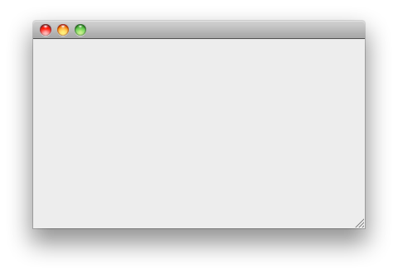
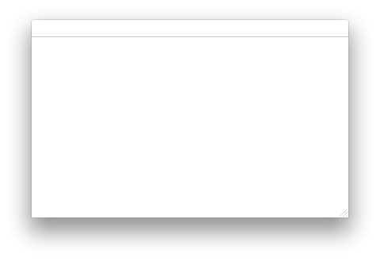
Graphic User Interface?
import wx
class MyApp(wx.App):
def __init__(self,redirect=False,filename=None):
wx.App.__init__(self,redirect,filename)
self.frame = wx.Frame(None,wx.ID_ANY)
self.panel = wx.Panel(self.frame,wx.ID_ANY)
if __name__ == '__main__':
app = MyApp()
app.MainLoop()
self.frame.Show()

Slide 6
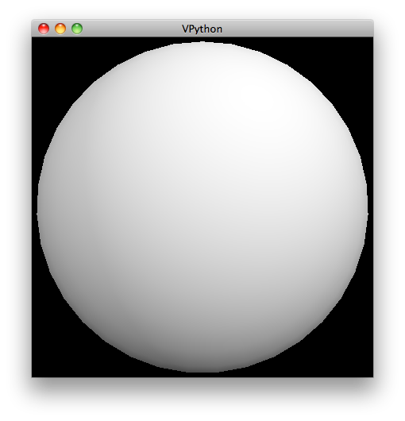
Fashion
>>> from visual import *
>>> sphere()

Slide 7
VPython
called "Visual"
realtime 3D graphics
interactive
simple
for science education and research"Matter & Interactions" -> "Lecture-demo"
with many usable features (such as textures, mouse event, ...etc)
work with another tools (eg: Blender)

Slide 8
Usage
>>> from __future__ import division
>>> from visual import *
>>> 'array' in dir() True
>>> 'pi' in dir() True
>>> 'random' in dir() True
Notes:
Demo: stars.py

Slide 9
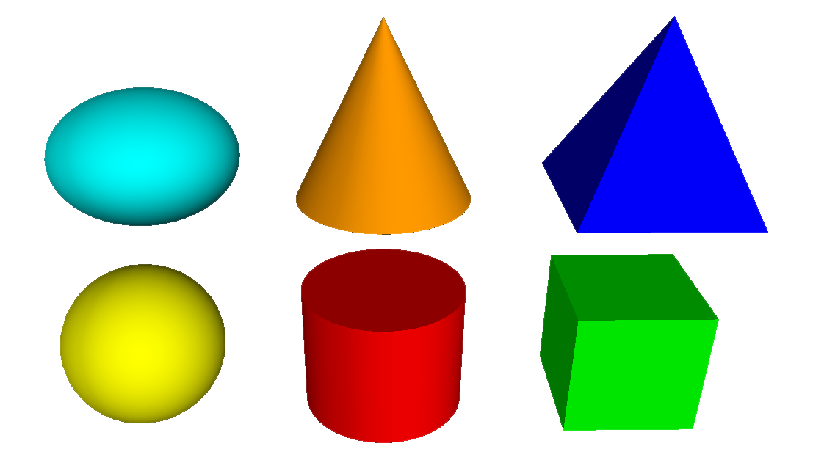
Objects
s = sphere(color=color.yellow, x=-2,y=-1,radius=1)
s = sphere()s.color = color.yellows.radius = 1s.pos = -2,-1

Slide 10
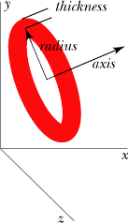
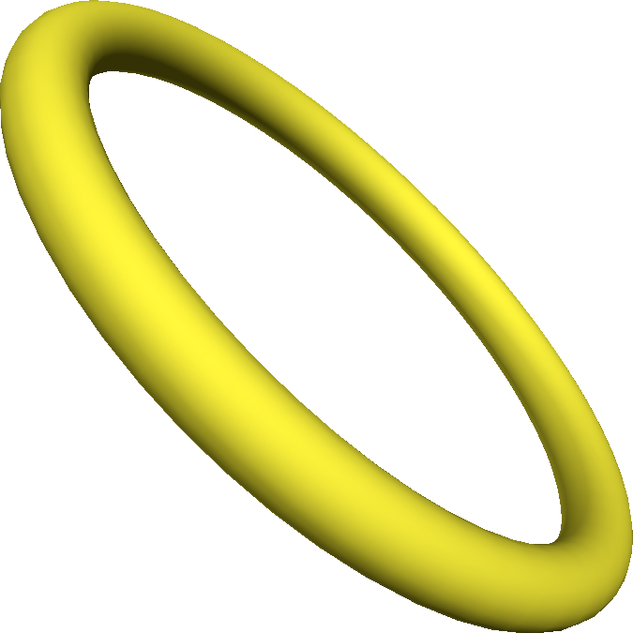
Attributes
refer to documentations
axis
pos
radius
thickness

Slide 11
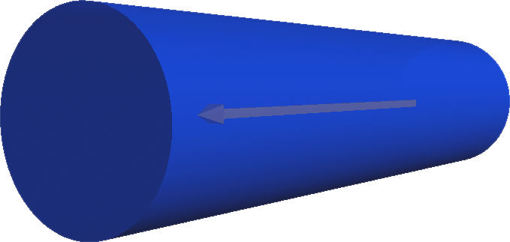
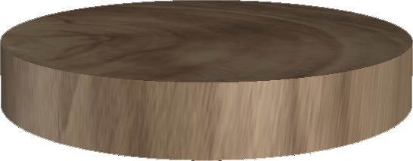
More attributes
c.color = color.blue c.opacity = 0.7
w.material = mateirals.wood

Slide 12
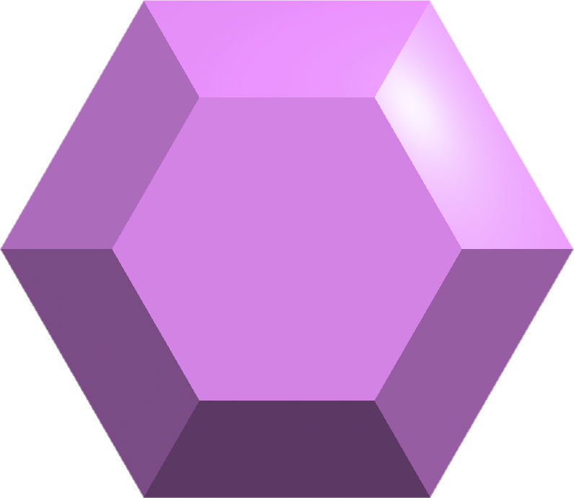
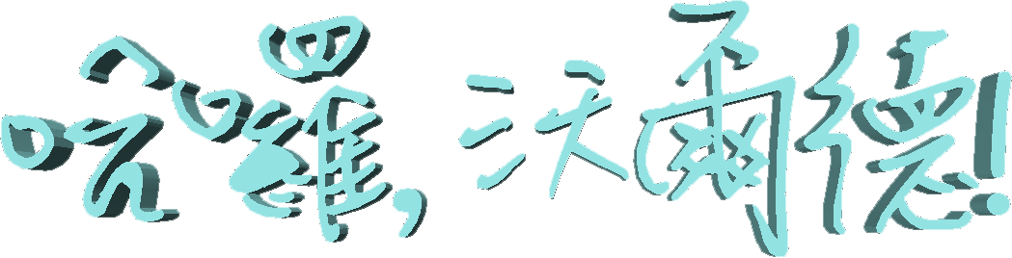
More 3D Objects
convex(pos=[(r*cos(x),r*sin(x),1-r)
for x in arange(-pi,pi,pi/3)
for r in (1,2)])
text(font="dft_lf3",
text=u"哈囉, 沃爾德!")

Slide 13
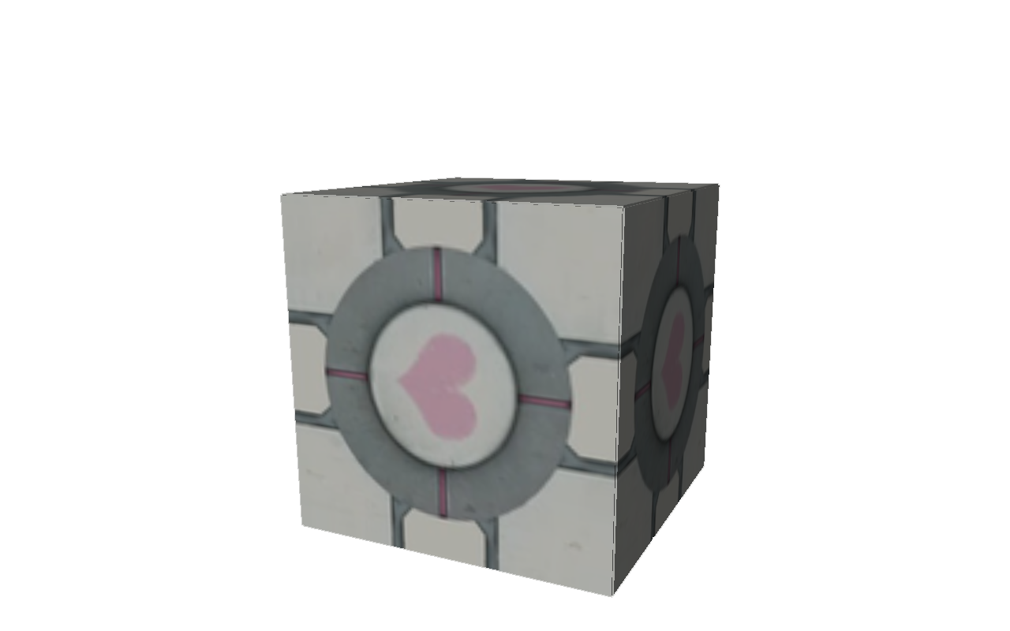
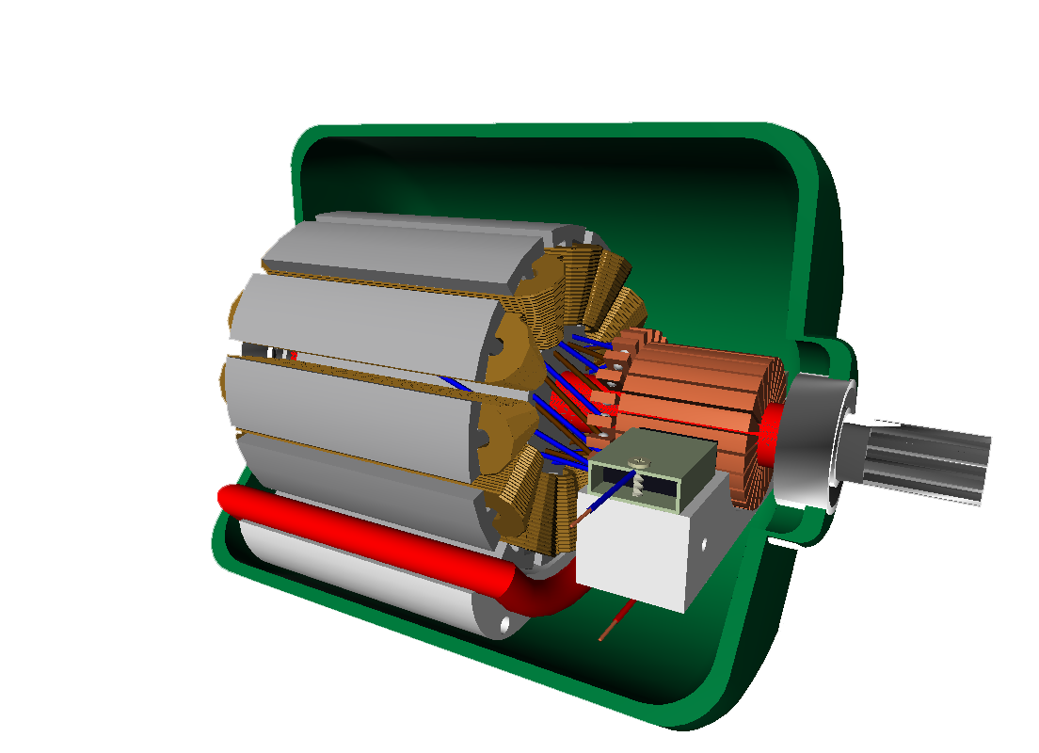
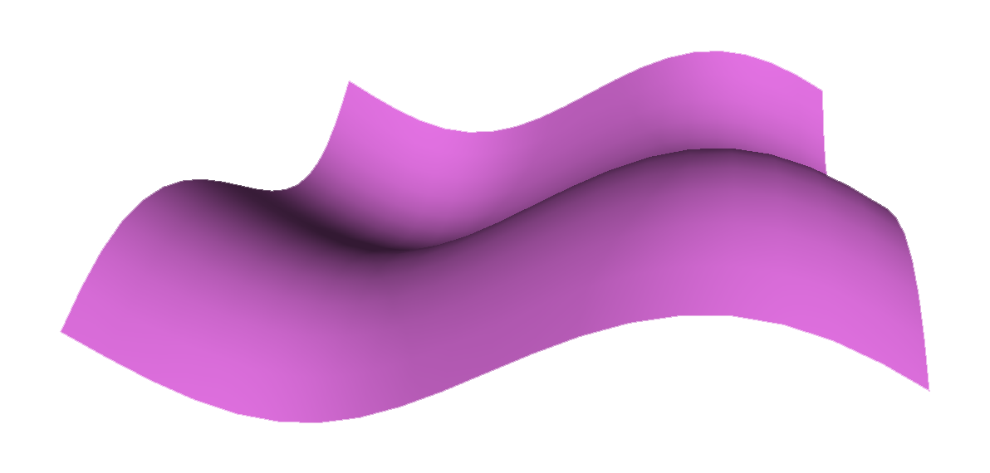
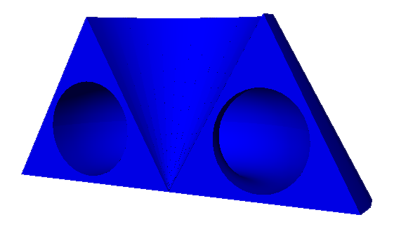
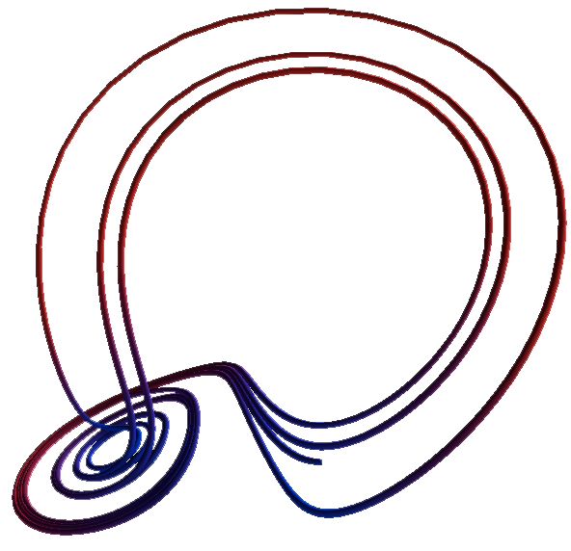
Customize Objects
color library
materials library and textures
curve and helix
faces and extrusion
paths and shapes library (Polygon object)

Slide 14
Other Objects
distant_light / local_light
lable
points
frame

Slide 15
Animation rotate
from visual import *
a = arrow(axis=(1,0,0))
while True:
rate(1)
a.rotate(axis=(0,0,1),
angle=-2*pi/60)
Notes:
Demo: rotate.py

Slide 16
Animation: move
from __future__ import division
from visual import *
N = Rate = 100
s = sphere(pos=(1,0,0))
while True:
rate(N)
s.x = s.x*cos(pi/N)-s.y*sin(pi/N)
s.y = s.y*cos(pi/N)+s.x*sin(pi/N)
Notes:
Demo: move.py && portal.py

Slide 17
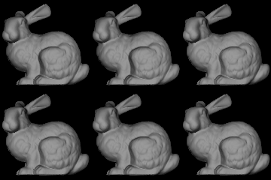
Using VPython for homework
Notes:
Demo: data && rabit.py

Slide 18
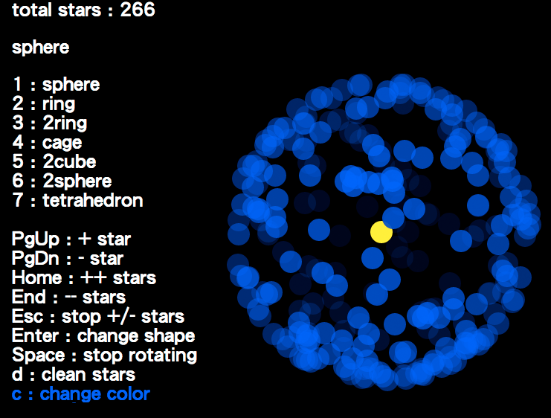
Using VPython for creativity
Notes:
Demo: universe.py

Slide 19
Event handlers (polling)
while True:
rate(100)
# clicked, drag, keydown
if scene.mouse.events:
evt = scene.mouse.getevent()
if scene.kb.keys:
evt = scene.kb.getkey()
Notes:
Demo: hanoi.py && tetris.py && snake.py

Slide 20
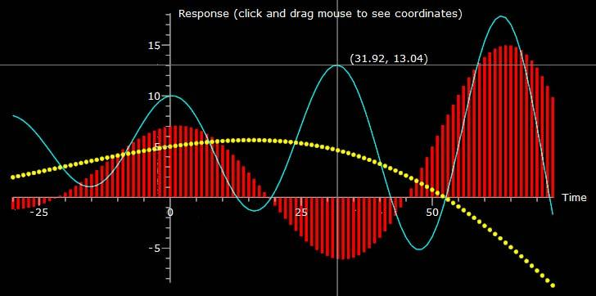
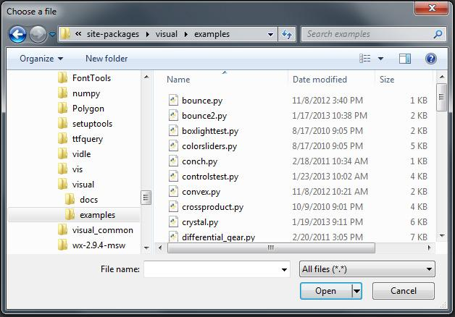
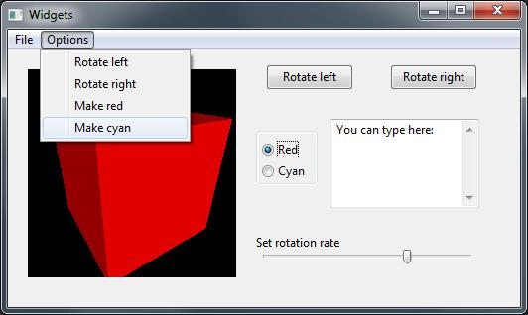
Other features
file dialog
embedded 3D display
2D Graph

Slide 21
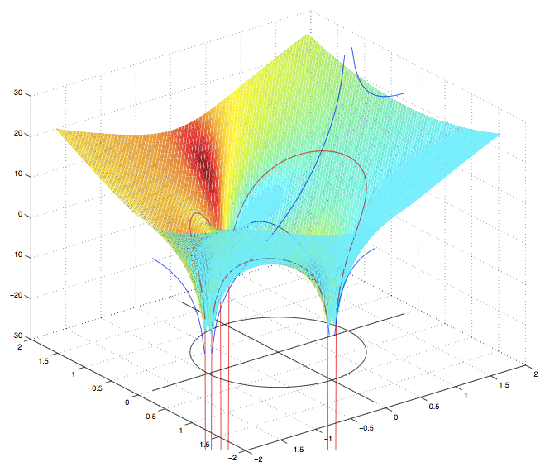
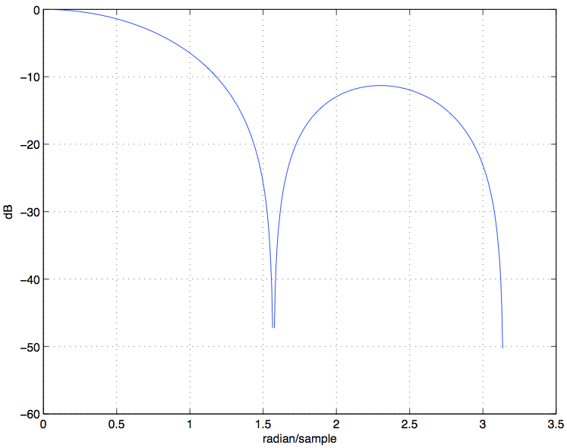
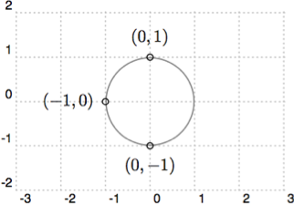
Digital Signal Processing?
Notes:
Demo: z-surface.py

Slide 22
Versions of VPython
 | callback event handler | base on wxPython | running on Python Shell
5.74 | ╳ | ╳ | ∆
6.05 | ✓ | ✓ | ╳

Slide 23
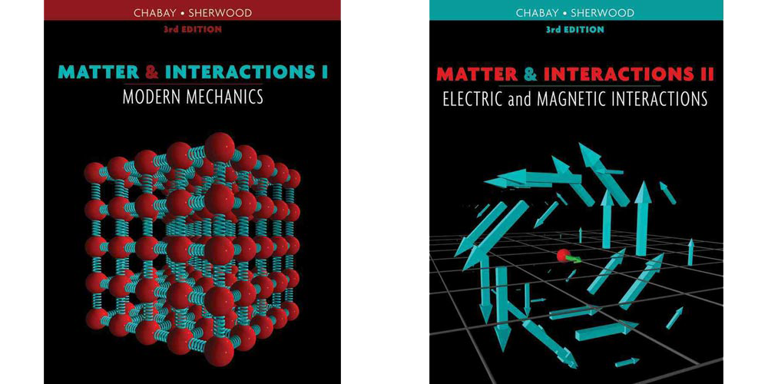
Resource
official documentation
user-contributed programs
site-packages/visual/example
"Matter & Interactions" -> "Lecture-demo"

Slide 24
Thank you
Questions?

